Slide 1
EE323 HW3: Simple Router
Jinwoo Kim
Some slides have been borrowed from “CS144 Simple Router” and Bob Lantz’s ones

Slide 2
You are going to mimic a “router”
Given a static network topology & routing table
No hardware router!, but software one! :)

Slide 3
You will be able to understand below things
How does a router handle ARP packets?
When does a router send ICMP packets?
How does a router use a routing table and send received packets?

Slide 4
How to do it?
Where will my routing logic run?
Where will the traffic come from?
How will I test my code?
We’re going to leverage “network emulation”

Slide 5
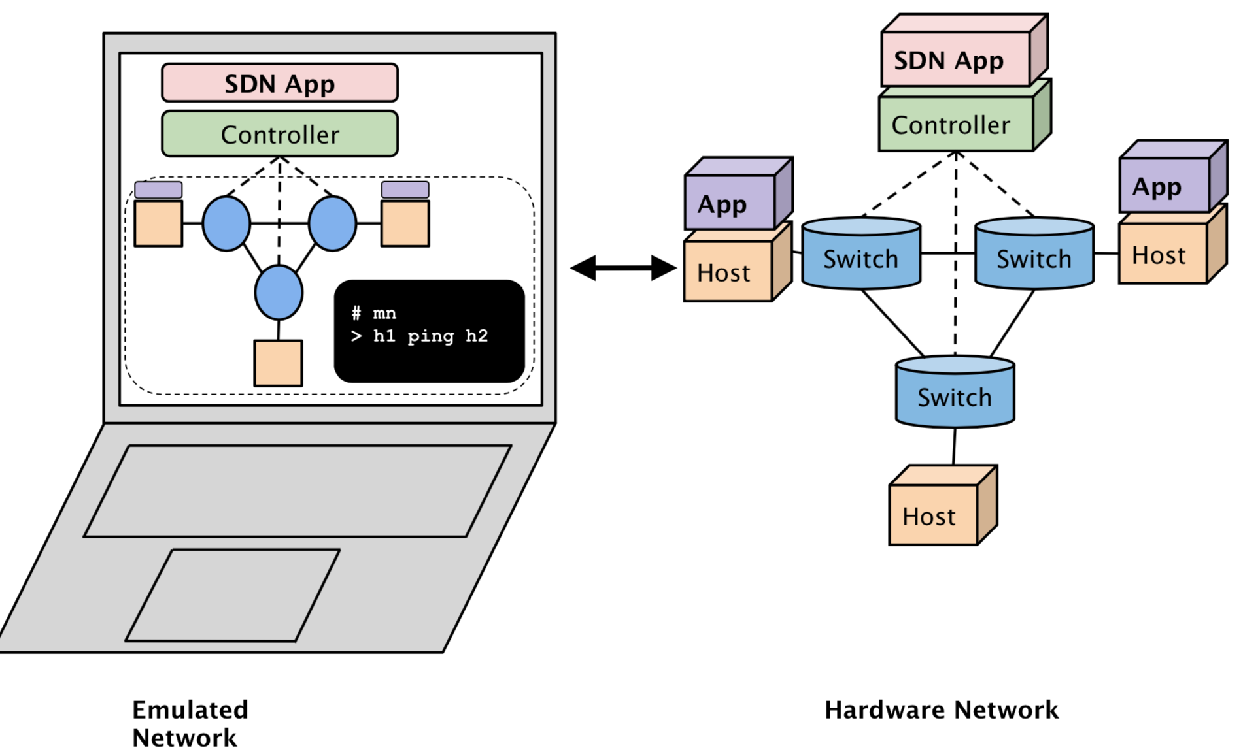
Mininet
An awesome network emulation tool
http://mininet.org

Slide 6
Simply run any network you want
With the help of OS-level virtualization and SDN (Software-defined Networking)
SDN may be discussed in our lecture
OS-level Virtualization
SDN

Slide 7
The target network architecture
This is the Mininet side
POX
httpd
httpd
Mediates this interaction
Your target
(you can think that those two routers are logically same to avoid confusion)

Slide 8
What is the POX?
A python-based SDN controller
./run_pox.sh runs a POX controller
Eyes everything and controls them
But, do not need to study it more deeply in this HW3
POX
Router
Router
Router

Slide 9
Let’s look at what’s happening

Slide 10
./run_pox.sh
POX
Port 6633, 6653
When you run POX, it listens port 6633, 6653

Slide 11
./run_mininet.sh
Server1
192.168.2.2
Server1
172.64.3.10
POX
Port 6633, 6653
OpenFlow
eth1
192.168.2.1
eth2
172.64.3.1
Router
(sw0)
When you run Mininet, it makes a virtualized network environment
And sw0 attaches to either port 6633 or 6653 of POX
Do not need to care about OpenFlow
eth3
10.0.1.1
Client
10.0.1.100

Slide 12
./router/sr
Server1
192.168.2.2
Server1
172.64.3.10
Interaction with router - SR thanks to POX and Openflow
2. Routing decision made
eth1
192.168.2.1
eth2
172.64.3.1
1. Packet sent to SR
Router
(sw0)
Static Router (sr)
3. Action is taken
eth3
10.0.1.1
Client
10.0.1.100
This is your part!

Slide 13
High-level Requirements
Static Router (sr)
Should enable below functions
Client -> Router
Ping
Traceroute
Client -> Server
Ping
Traceroute
Downloading a file using wget (via http://)

Slide 14
Internal Flow Chart
Receive Raw Ethernet Frame
sr_handlepacket() is called (in sr_router.c)
It’s an IP Packet
It’s an ARP packet

Slide 15
Internal Flow Chart (con’td)
Receive Raw Ethernet Frame
implement sr_handlearp() in sr_router.c
It’s an IP Packet
It’s an ARP packet
Reply to me
Request to me
Refer to the comments in arpcache.h
Cache it
Go through my request queue
Send outstanding packets
Construct an ARP reply and send it back
implement handle_arpreq() in sr_arpcache.c

Slide 16
Internal Flow Chart (con’td)
Receive Raw Ethernet Frame
It’s an IP Packet
It’s an ARP packet
It’s for me
Not for me
Static routing table (ee323_sr/router/rtable)
Check routing table, perform LPM
If it’s ICMP echo req, send echo reply
Or if it’s TCP/UDP, send ICMP port unreachable
Destination Network | Gateway | Network Mask | Iface
10.0.1.100 | 10.0.1.100 | 255.255.255.255 | eth3
192.168.2.2 | 192.168.2.2 | 255.255.255.255 | eth1
172.64.3.10 | 172.64.3.10 | 255.255.255.255 | eth2

Slide 17
Internal Flow Chart (con’td)
Receive Raw Ethernet Frame
It’s an IP Packet
It’s an ARP packet
It’s for me
Not for me
Check routing table, perform LPM
Be careful about TYPE and CODE values
If it’s ICMP echo req, send echo reply
Or if it’s TCP/UDP, send ICMP port unreachable
No match
Send ICMP net unreachable

Slide 18
Internal Flow Chart (con’td)
Receive Raw Ethernet Frame
It’s an IP Packet
It’s an ARP packet
Not for me
TTL--, recalculate checksum
Send frame to next hop
Check routing table, perform LPM
Match
Check ARP cache
Hit
While keeping the IP packets in the request queue
Miss
Resent >5 times
Send ARP request
Send ICMP net unreachable

Slide 19
traceroute
Server1
192.168.2.2
Server1
172.64.3.10
A tool for finding network paths using TTL fields
How?
Send a TTL=1 packet and read the response IP address
Incrementally send a packet by the adding TTL value
TTL = 0
ICMP time exceeded
eth1
192.168.2.1
eth2
172.64.3.1
Router
(sw0)
eth3
10.0.1.1
TTL = 0
TTL = 1
ICMP time exceeded
TTL = 1
Client
10.0.1.100
TTL = 2

Slide 20
Summary: what your routing logic needs to do
Route Ethernet frames between the client and the HTTP servers
Handle ARP request and replies
Handle traceroutes
Generate Time Exceeded Message
Handle TCP/UDP packets sent to one of the router's interfaces
Generate ICMP Port Unreachable
Respond to ICMP echo requests
Maintain an ARP cache
See webpage for requirements

Slide 21
Example: Testing method
In Mininet console,
mininet> client ping 10.0.1.1
mininet> client wget http://192.168.2.2/
mininet> client traceroute server1
mininet> client

Slide 22
Some Advice
Be thorough in your testing
Be careful when implementing LPM (Longest Prefix Match)
Don’t get mixed up with endianness: the VM is little-endian, the network is big-endian
Try to put calls to hton, ntoh in a single place and be consistent with their usage
Write good quality code
Do not hardcode constants, avoid code duplication

Slide 23
Things that may be useful
Mininet console
./run_mininet will get you a command line interface (CLI)
Debug functions in sr_utils.c
print_hdrs(), print_addr_ip_int()
GDB/Valgrind
To check your memory corruption

Slide 24
Question?
Jinwoo Kim (jinwoo.kim@kaist.ac.kr)

